Slide 1
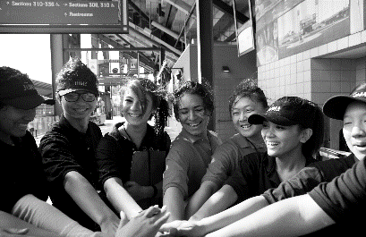
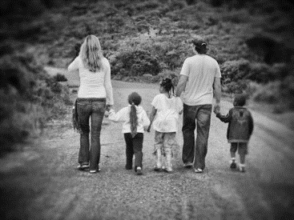
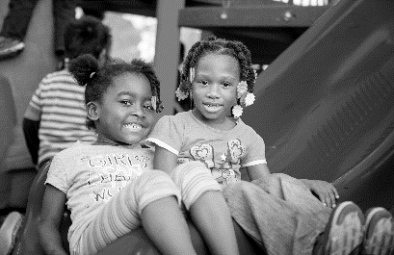
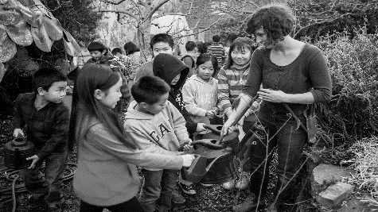
Department of Children, Youth and Their Families
Maria Su, Psy.D.
EXECUTIVE DIRECTOR
London Breed
MAYOR
Sugary Drinks Distributor Tax Update
March 4, 2020
Presentation by: Michelle Kim, SDDTAC Seat 13

Slide 2
Agenda
Provide Context around SDDT and SDDTAC
Overview of previous SDDT and current funding allocations
Overview of SDDTAC’s current funding recommendations FY2020-2021 and FY 2021-22

Slide 3
General Overview – SDDT & SDDTAC
In November of 2016, the voters of San Francisco approved the passage of Proposition V. Proposition V established a 1 cent per ounce fee on the initial distribution of a bottled sugar-sweetened beverage, syrup, or powder, within the City and County of San Francisco.
The passage of Proposition V established two pieces of law: the Sugary Drinks Distributor Tax (SDDT) and the Sugary Drinks Distributor Tax Advisory Committee (SDDTAC)

Slide 4
General Overview – SDDT & SDDTAC
The Sugary Drinks Distributor Tax (SDDT) is a general excise tax on the privilege of conducting business within the City and County of San Francisco. It is not a sales tax or use tax or other excise tax on the sale, consumption, or use of sugar-sweetened beverages. The funds collected from this tax are to be deposited in the General Fund.

Slide 5
General Overview – SDDT & SDDTAC
Sugary Drinks Tax Advisory Committee (SDDTAC) - The powers and duties of the Committee are to make recommendations to the Mayor and the Board of Supervisors on the effectiveness of the Sugary Drinks Distributor Tax and to submit a report that evaluates the impact of the Sugary Drinks Distributor Tax on beverage prices, consumer purchasing behavior, and public health. The Committee is to also provide recommendations regarding the potential establishment and/or funding of programs to reduce the consumption of sugar-sweetened beverages in San Francisco.
Notes:
SDDTAC only provides recommendations regarding SDDT. It is still up to the Mayor and Board of Supervisors to decide how SDDT funds should be spent. Folks wanting to vocalized their thoughts on SDDT and how it should be spent (whether they agree with SDDTAC Rex or not) should inform the Mayor and Board of Supervisors during their budget process.

Slide 6
Current SDDTAC members
Seat 1 | Vanessa Bohm | Health Equity- Latino/Chicano/Indigena
Seat 2 | John Maa | Health Equity – Asian/Pacific Islander
Seat 3 | Joi Jackson-Morgan | Health Equity – Black/African American
Seat 4 | Roberto Ariel Vargas | Research/Medical Institutions
Seat 5 | Jonathan Butler | Research/Medical Institutions
Seat 6 | Aaron Kunz | Youth Seat
Seat 7 | Larry McClendon | Office of Economic and Workforce Development
Seat 8 | Saeeda Hafiz | San Francisco Unified School District
Seat 9 | Lauren Heumann | San Francisco Unified School District
Seat 10 | Rita Nguyen | Department of Public Health – Chronic Disease
Seat 11 | Irene Hilton | Department of Public Health - Oral Health
Seat 12 | Shelley Dyer | Department of Public Health - Food Access/Security
Seat 13 | Michelle Kim | Department of Children Youth and Their Families
Seat 14 | Linda Barnard | Recreation and Parks Department
Seat 15 | Janna N. Cordeiro | SFUSD Parent Advisory Council
Seat 16 | Derik Aoki | Children 0-5 Years Old
SDDTAC consist of 16 voting members, who are appointed by either the Board of Supervisors or certain City departments.

Slide 7
Projected SDDT Revenue
City of San Francisco operates on a 2 year budget cycle, which is reviewed by Mayor and Board of Supervisors on an annual basis
For FY20-21 and FY 21-22, SDDTAC had $11.2M and $10.3M available for recommendation

Slide 8
Healthy Add-Backs
Notes:
These Healthy Addbacks i originally from SDDT fund that was allocated in FY17-18 are

Slide 9
SDDT funds that were allocated by Mayor and Board of Supervisors over the past fiscal years.
Notes:
Increase in Physical Activity funding was for Mayor's Requity/Scholarship and Outreach Program (via Rec and Park). Majority of funding came from the community-based grants bucket, specifically reductions in grants and media.

Slide 10
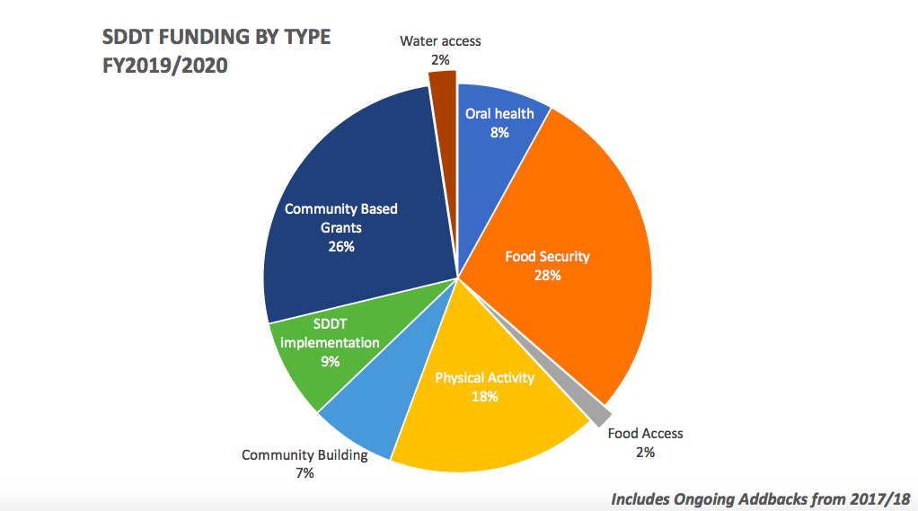
Percent of SDDT funds that were
allocated by Mayor and Board of Supervisors in FY2019/2020 by funding type
Notes:
Percentage of funding type changes each fiscal year but this is the general overview for FY19-20

Slide 11
Context around funding categories
As defined in the 2019 SDDTAC annual report (p. 29-30):
Food security is the ability, at all times, to obtain and consume enough nutritious food to support an active, healthy life.
For example, healthy food purchase supplement, congegrate and home delivered meals funded via healthy add-backs is under food security
Food Access is the ability to obtain affordable, nutritious, and culturally appropriate foods safely and conveniently
For example, healthy retail is under food access

Slide 12
Highlights of Funding SDDTAC Rx Changes
Full details of SDDTAC Rx will be available in annual report
Increase in current funding Rx categories for FY 20-21 and FY 21-22
Healthy Food Purchasing Supplement: $1.2 MIL instead of $1 MIL ($200K increase)
New category: Breastfeeding: $175K
One-time funding Rx for FY20-21
One-time funding for TA/Capacity building for CBOs: $470K
SFUSD Kitchen/Food Infrastructure Upgrade: $330K
Support for Small Businesses: $250K
Notes:
Slide only include highlights that may be relevent to FSTF work. Current SDDTAC Rx not available in a chart that can be seen easily put on PPT – best to refer to annual report for chart details for comparison when available

Slide 13
Next Steps
Questions regarding the San Francisco budget timeline and process? Attend the San Francisco City Budget Training sponsored by Budget Justice Coalition, B'MAGIC & & Mo'MAGIC on Wednesday, March 11, 2020 at 10am-1pm. Must RSVP via this Link
SDDTAC Meeting – Wednesday, March 18, 2020 at 5pm @ 1390 Market St, Suite 900
Finalize written sections of annual report
Notes:
SDDTAC only provides recommendations regarding SDDT. It is still up to the Mayor and Board of Supervisors to decide how SDDT funds should be spent. Folks wanting to vocalized their thoughts on SDDT and how it should be spent (whether they agree with SDDTAC Rex or not) should inform the Mayor and Board of Supervisors during their budget process.
Link

Slide 14
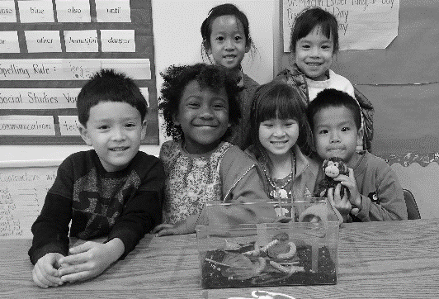
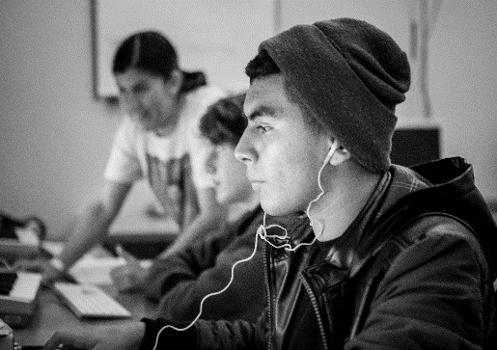
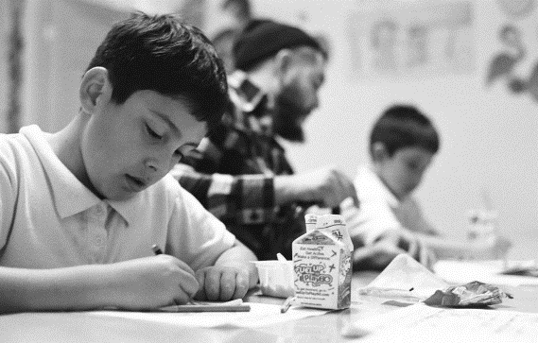
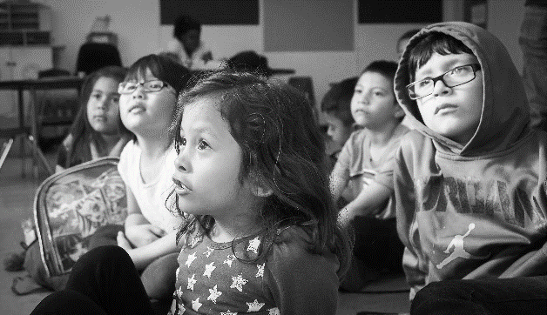
Questions?

